Slide 1




The final conference of the POLNOR-LEADER project
Tests of Satellite Link for Flight Monitoring and Measurement Transmission
M. Paszkuta

Slide 2
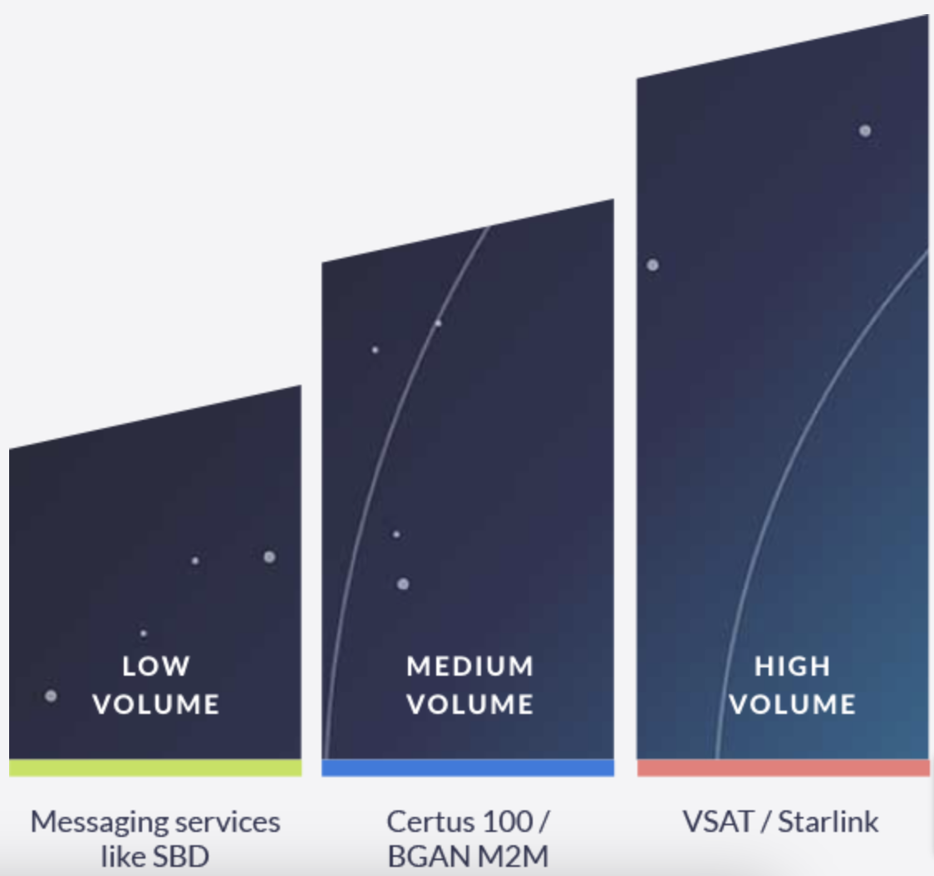
Satellite Links
Overview of available solutions
Low volume:
  (Iridium SBD and Inmarsat IDP)
  Telemetry, sensor data.
  A few bytes to a few kilobytes.
Medium Volume:
  (Iridium Certus 100 and Inmarsat BGAN M2M)
  Audio, images, log files.
  Kilobytes to a few megabytes.
High Volume:
  (Starlink and VSAT)
  Video, high-resolution images.
  Megabytes to gigabytes.

Slide 3

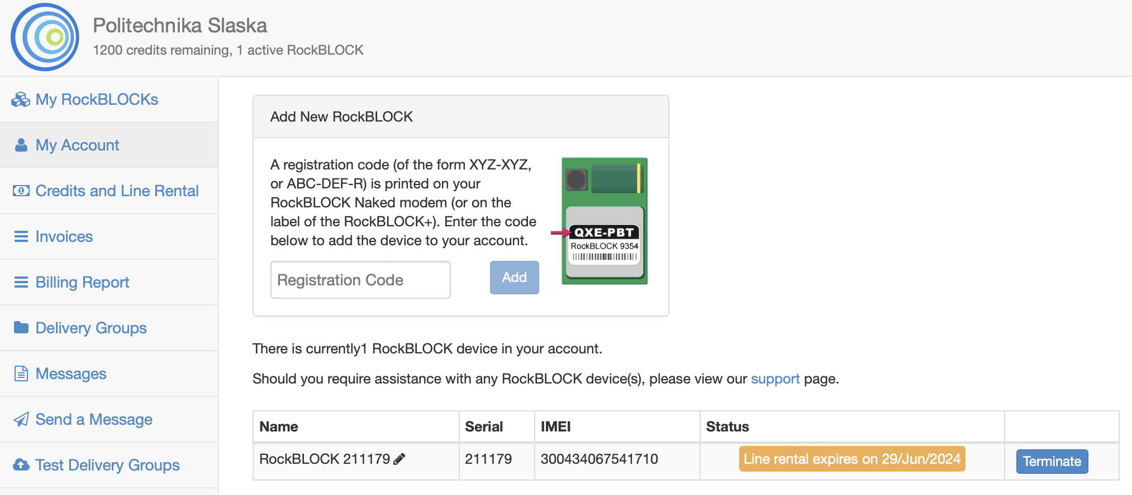
RockBLOCK Rock7 service
Iridium operator – Rock7 Ground Control Technologies UK Ltd
We have chosen RockBLOCK Rock7 as our Iridium operator.
The company offers RockBLOCK 9603 modems, which are based on the Iridium 9603N transceivers. It is currently one of the smallest and lightest modems on the market.
These ready-to-use devices allow for fast integration with computing modules and flight controllers such as PixHawk.
The admin web service provided by Rock7 offers various management options.
Users can send and receive messages directly from the web interface and monitor active devices.

Slide 4
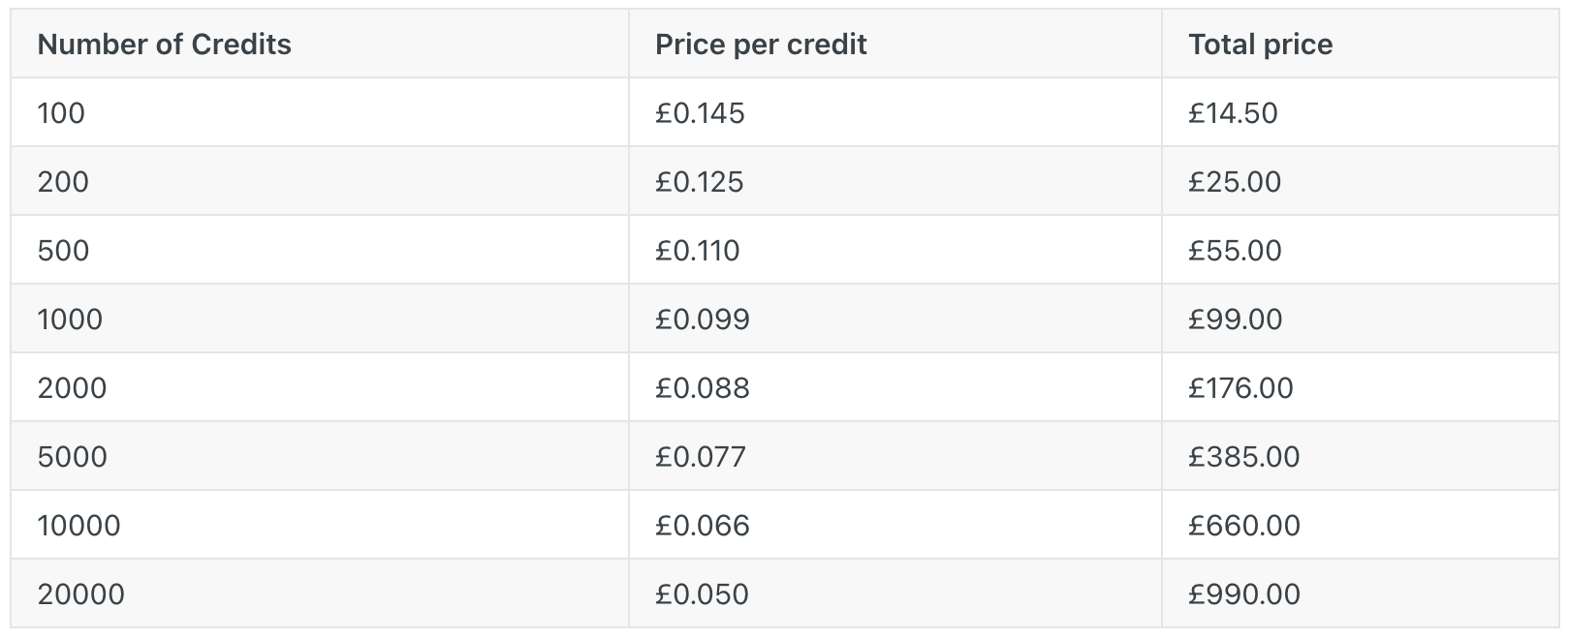
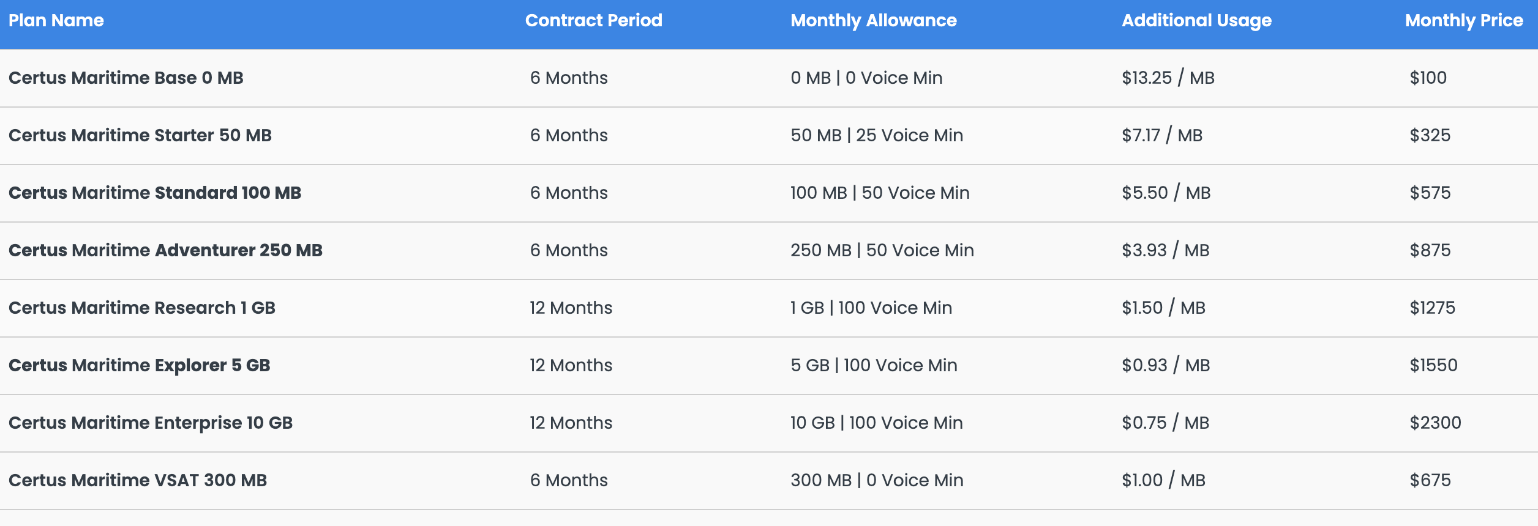
RockBLOCK Rock7
Rock7 Iridium pay-as-you-go tariff
Transmission cost and billing options
Line rental cost: £13.00 ($17.00)
Pay-as-you-go tariffs offer great flexibility for development purposes.
The validity of the credits is 1 year.
1 credit is used per 50 bytes (or part thereof) of message sent or received.
1 credit is used if you check your mailbox and there are no messages waiting.
1 MB cost from £1048.00 to £3041.00.
Apollo Satellite Iridium Certus Maritime Service

Slide 5

Iridium Satellite Constellation
Coverage map – spot beam footprint of Iridium satellite system

Slide 6
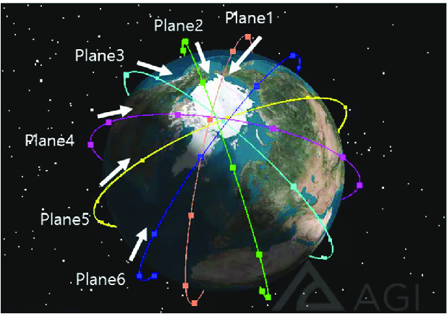
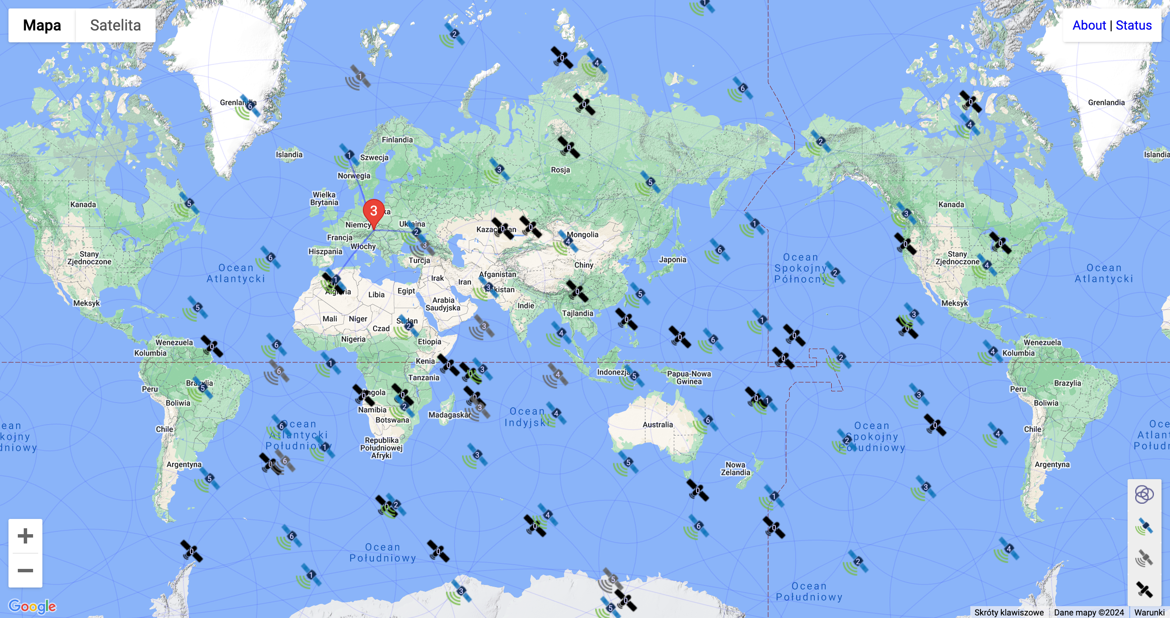
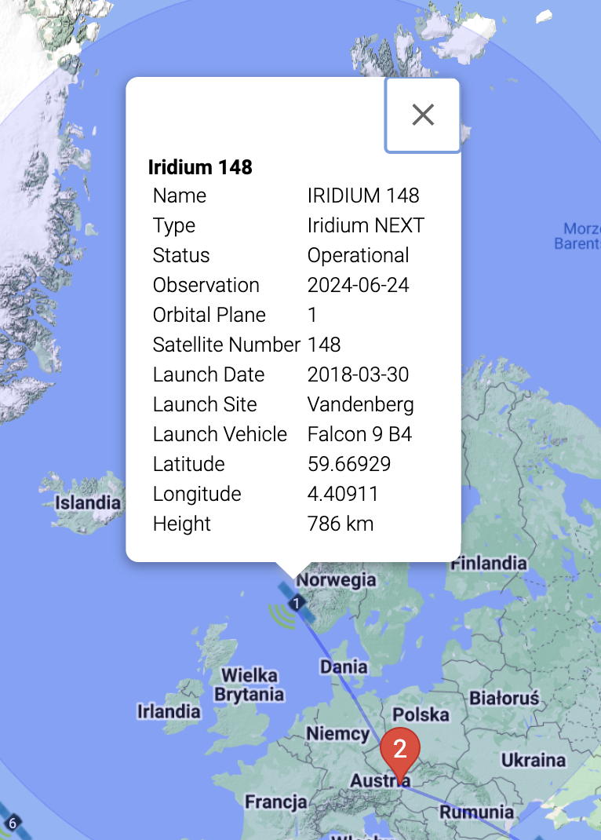
Iridium Satellite Constellation
The Iridium satellites live map
https://iridiumwhere.com

Slide 7
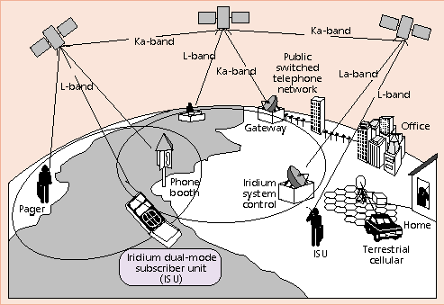

Technical Description of Iridium
General information about Iridium Satellite System
The original Iridium satellites were launched in the late 1990s. A new generation, Iridium NEXT, was launched between 2017 and 2019 to replace the original constellation and enhance service capabilities.
The name “Iridium” was chosen because the original design called for 77 satellites, matching the atomic number of the element iridium.
The Iridium satellite system has three segments:
satellites constellation,
terrestrial base-stations,
subscriber terminals/modems.

Slide 8
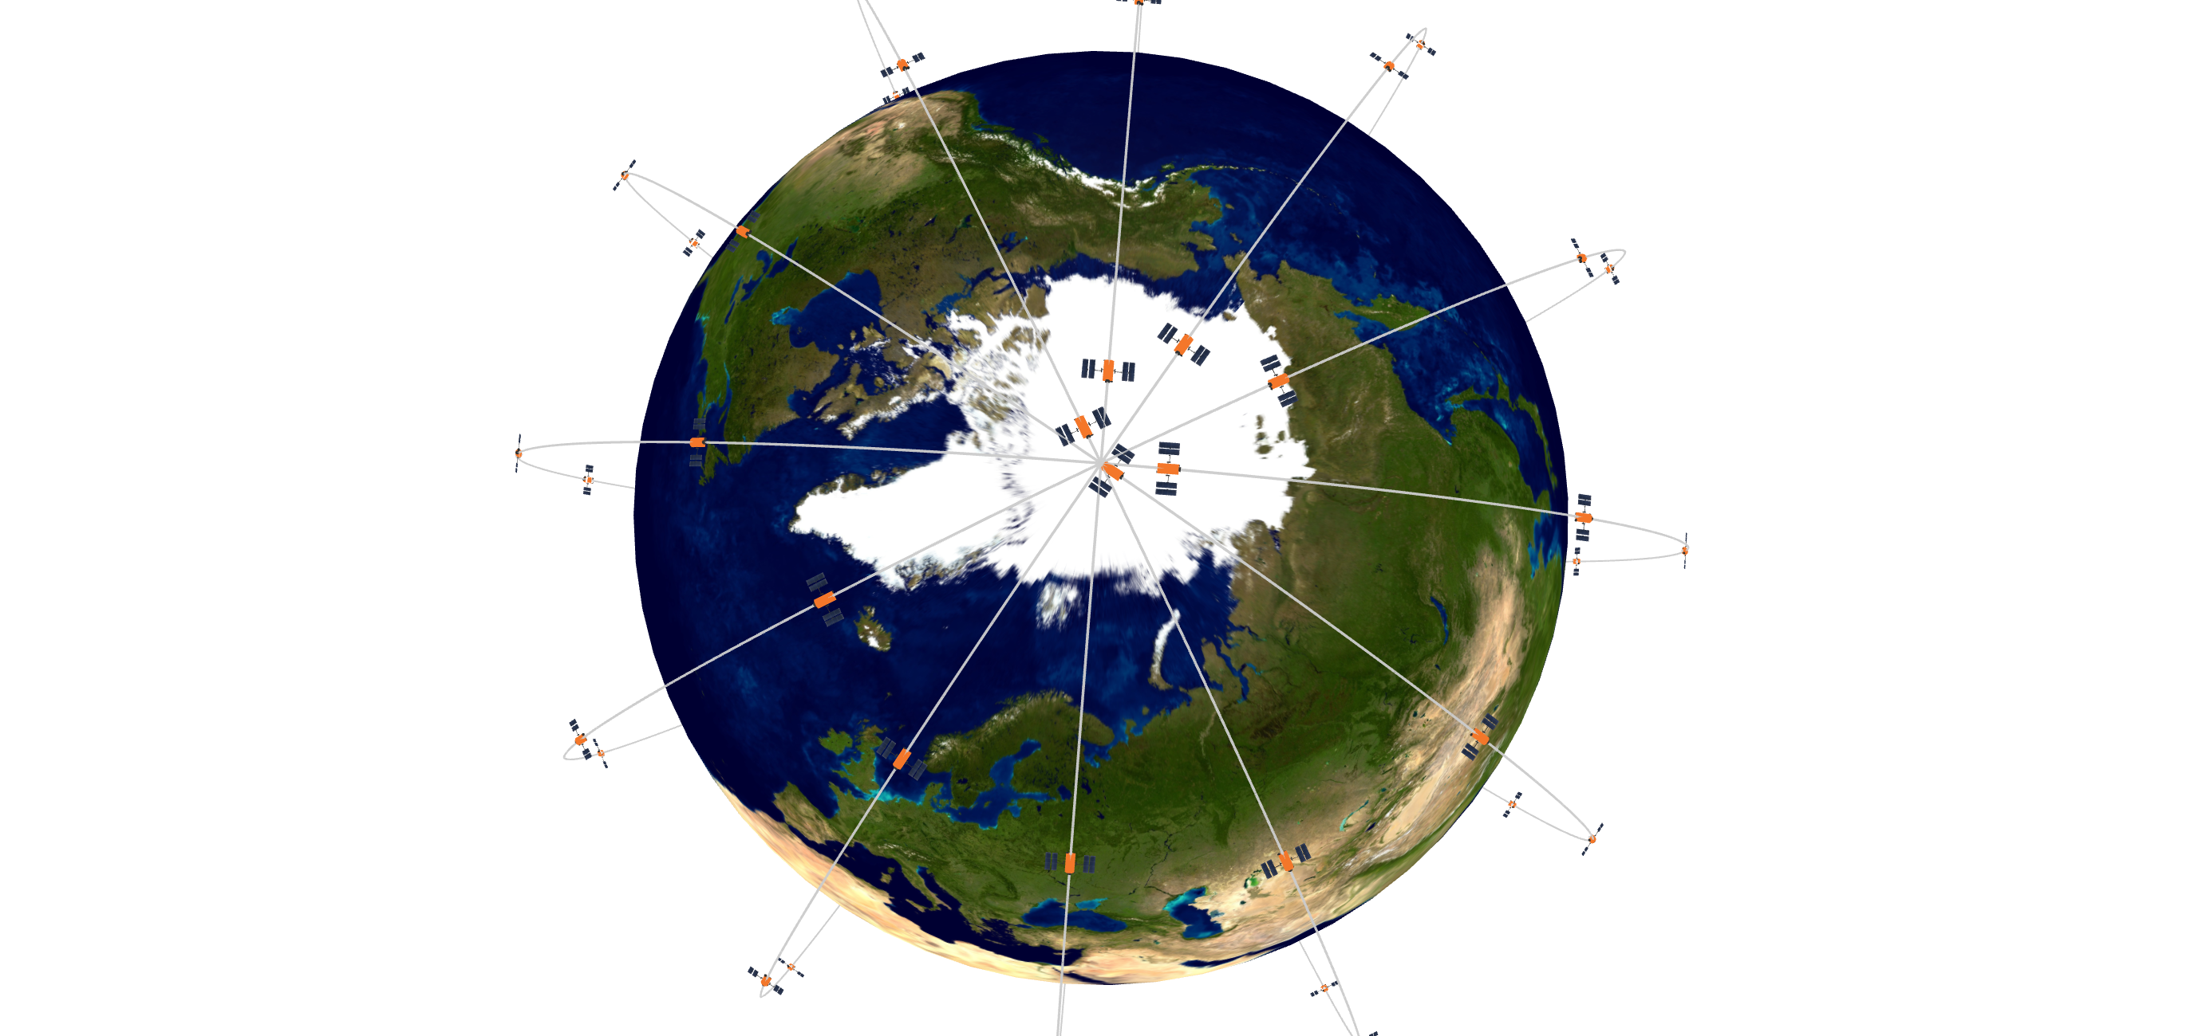
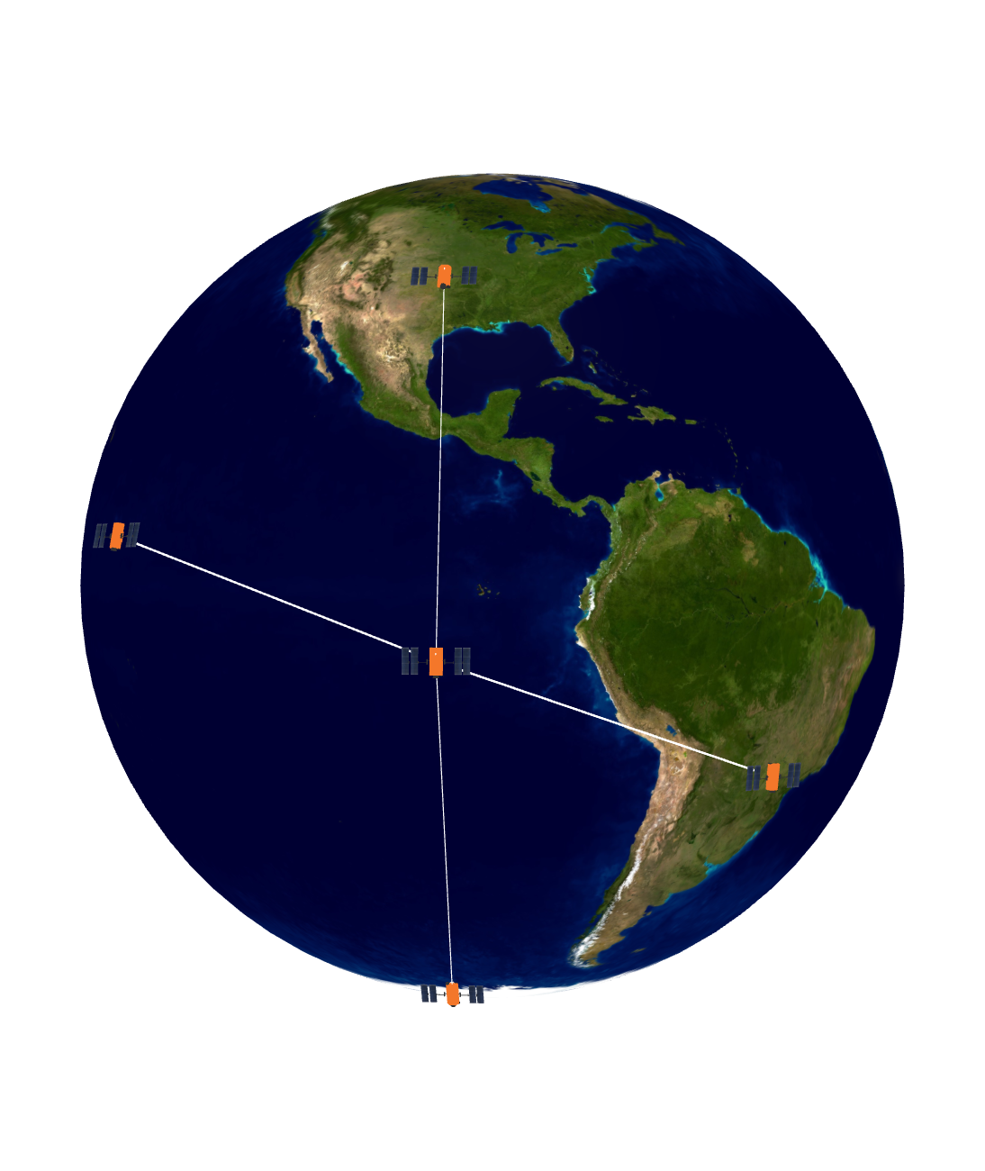
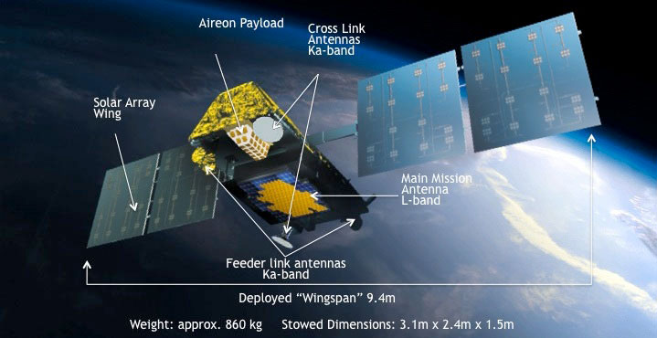
Technical Description of Iridium
Satellites constellation of Iridium
Constellation of 66 satellites Iridium NEXT (6 orbits)
Low-Earth Orbit (LEO)
~780 kilometres (485 miles) above the Earth
Speed: ~27000 km/h (7500 m/s)
L-band (1.6 GHz) frequencies for the end users,
K/Ka-band (19/29 GHz) for gateway communication,
K-band (23 GHz) for the inter-satellite links
Good coverage in the remote high-latitude regions
Each satellites is cross-linked to four others
Together, the satellites create a global mesh of coverage over the Earth
Cross-links provide network optimization and redundancy (data could be rerouted)
Redundant monitoring centers:
- Network Operations Center (NOC)
Tempe, Arizona, USA
- Emergency Network Operations Center (ENOC) Leesburg, Virginia, USA
Orbit period: 100.13 minutes
Transmitter power: 1400W
Bandwidth: 10.5 MHz
41.67 kHz per channel
Number of Channels: 240
(20 per cell)
Band Center Frequency: 1616 + 0.021875(2n − 1) MHz where (n = 1, ..., 240)

Slide 9

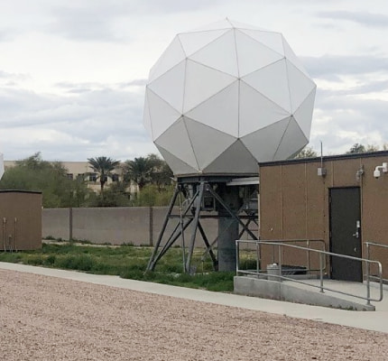
Technical Description of Iridium
Terrestrial base-stations of Iridium
Iridium has multiple Gateway Earth Stations (GES), located around the world where terrestrial base-stations are situated
These gateways act as the interface between the satellite network and the public switched telephone network (PSTN) and the global Internet network.
The primary location of the Iridium gateways are:
- Tempe, Arizona, USA - This is the primary gateway for the Iridium network, managed by Iridium Communications Inc.
- Fairbanks, Alaska, USA - This gateway supports communications in the polar regions and is operated in collaboration with the University of Alaska Fairbanks.
- Svalbard, Norway - Located in the Arctic region, this gateway ensures connectivity in the high northern latitudes.
- Beijing, China - Operated by China Telecommunications Corporation, it serves the Asia-Pacific region.
- Punta Arenas, Chile

Slide 10
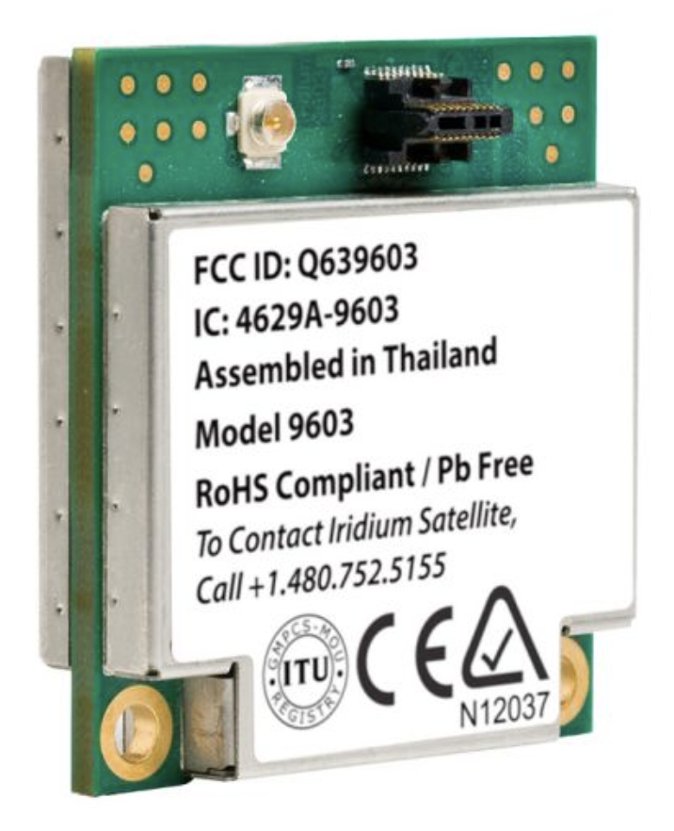
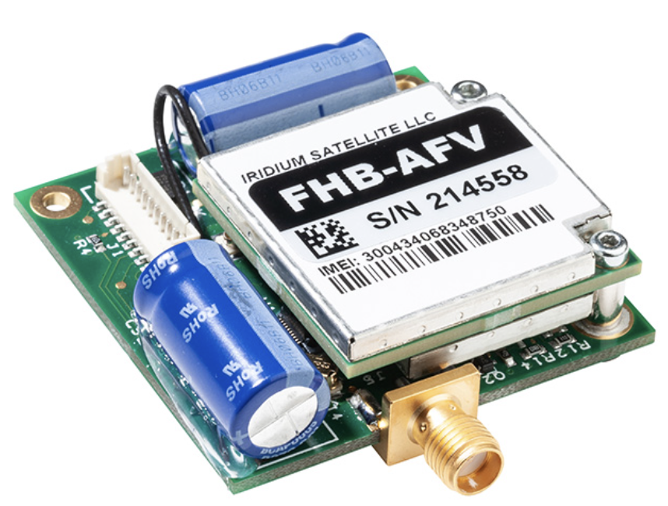
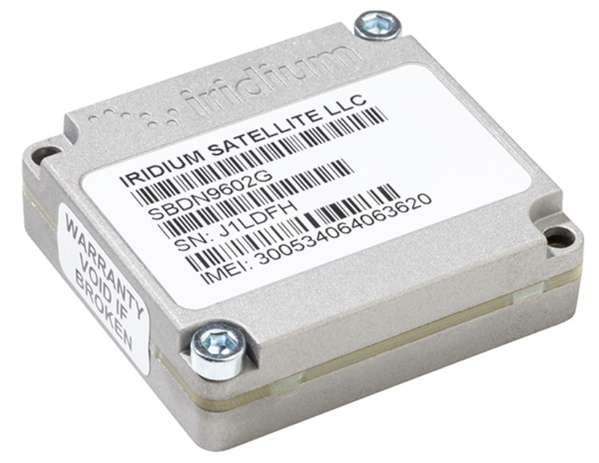
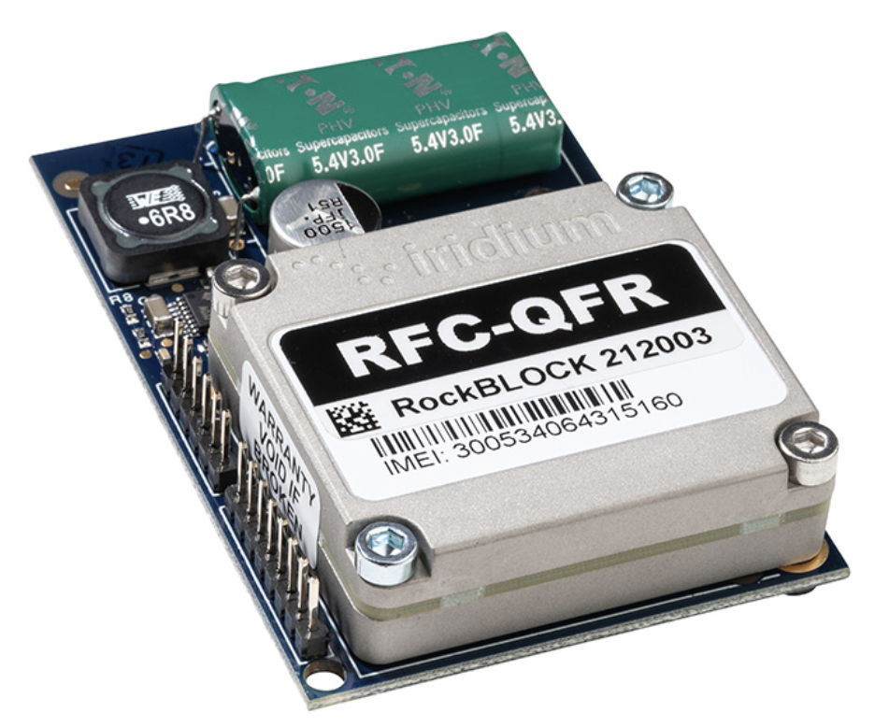
Technical Description of Iridium
RockBLOCK 9603
Terminal and modems based on 9602N/9603N
Iridium 9603N
Iridium 9603N parameters
Iridium Short Burst Data (SBD)
AT commands-based control
3-wire UART communication (TX/RX/GND)
Low weight: 36 grams including antenna
Small form factor
45.0 x 45.0 x 15.0m
Low-power consumption
100mA – 450mA, integrated supercapacitor
Voltage required:
3.4-5.4V
Frequency range: 1616 MHz to 1626.5 MHz
Hight temperature range and humidity:
-45 to 85 degrees C, ≤ 75% relative humidity
No SIM card
Price: ~300 USD
Iridium 9602N
RockBLOCK 9602
Notes:
The device contains a supercapacitor that acts as an energy reservoir and buffers the highly pulsed nature of its internal circuits.

Slide 11
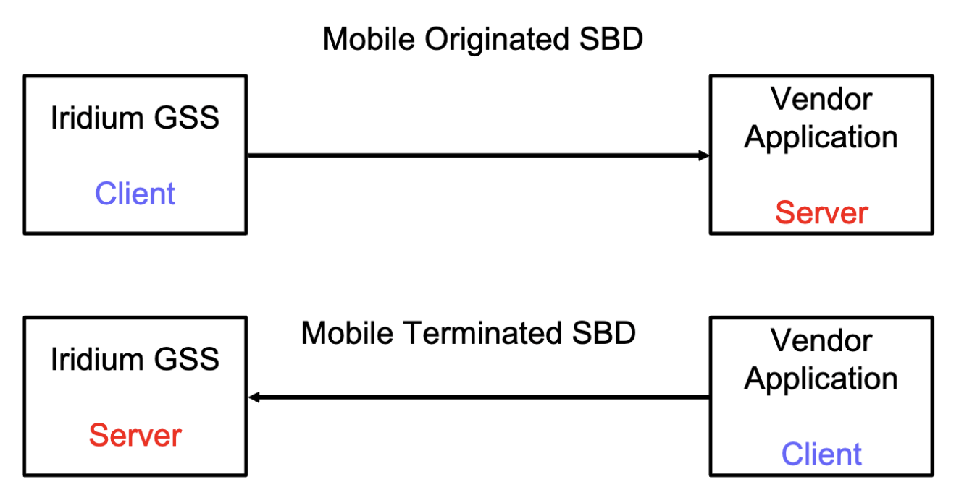
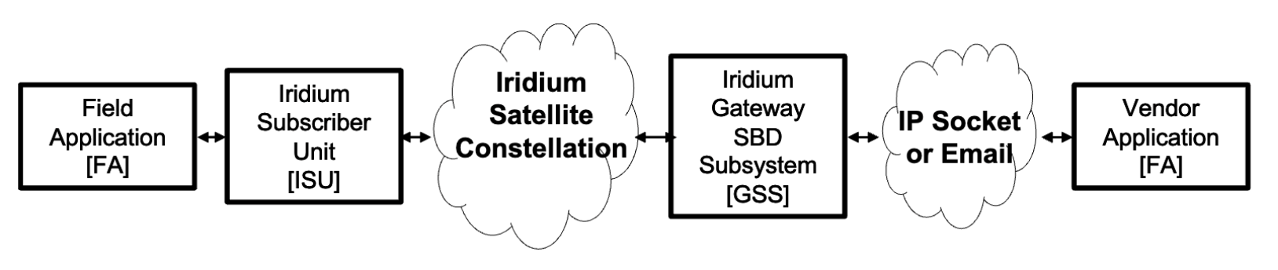
Iridium Short Burst Data (SBD)
Enabling Efficient and Reliable Packet-Based Data Communications
SBD (Short Burst Data) is a messaging system with limited bandwidth, allowing for the transmission of packets up to 340 bytes in size, while receiving packets of 270 bytes.
The modem uses a technique called “burst” transmission, which allows it to send data in short, quick bursts. This helps to conserve power and improve battery life.
Typically, a successful SBD transmission has an average current consumption of between 45 and 50 milliamps (averaged over a 60 second period).
In optimal conditions, with an unobstructed view of the sky, SBD allows for approximately one send/receive operation every 10 seconds.
The latency from the gateway is less than 1 second.
SBD may not be suitable for scenarios where very low latency is crucial or when the data to be transmitted exceeds a few thousand bytes.
Binary protocols like MAVLink can reduce data transfer requirements. Message sizes should be minimized to 50 bytes or less to minimize additional costs.

Slide 12
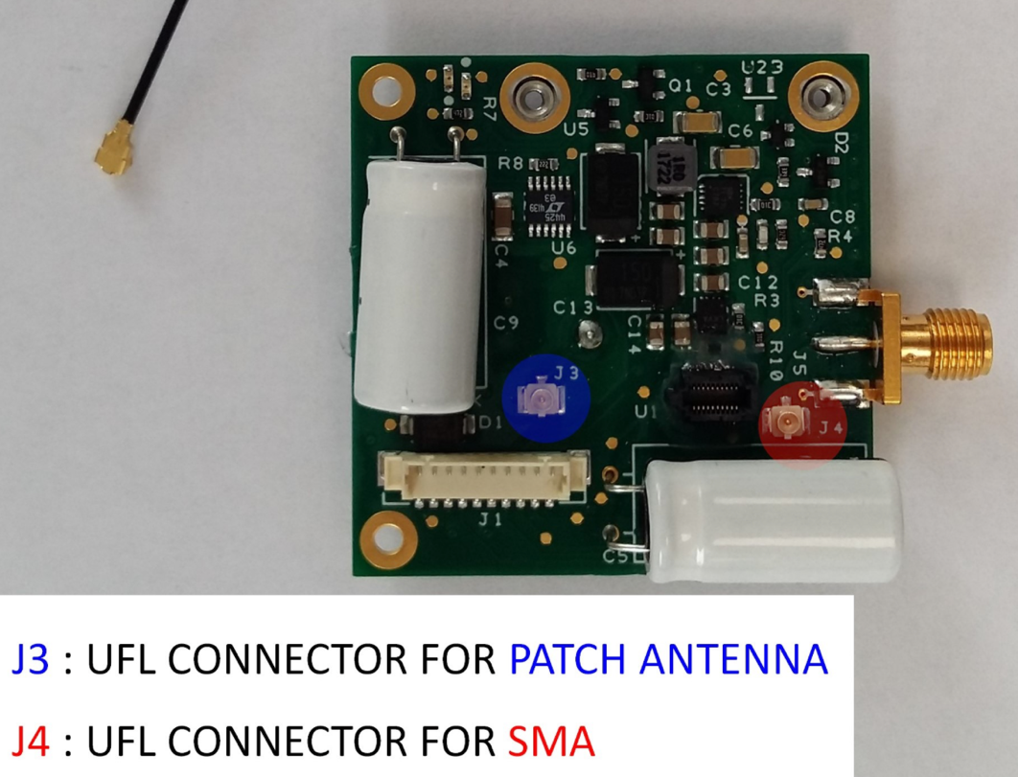
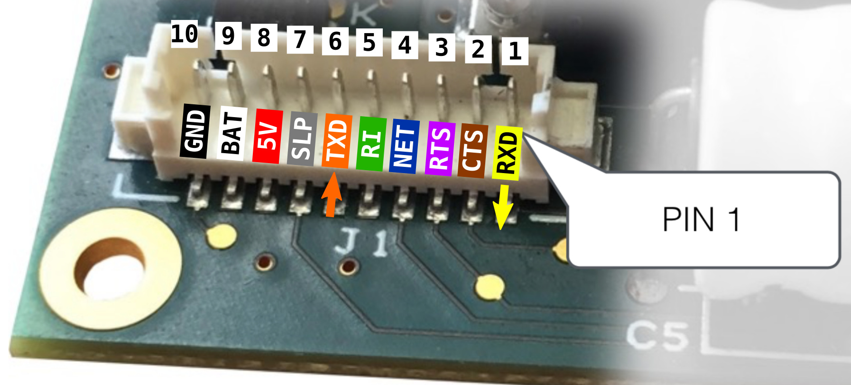
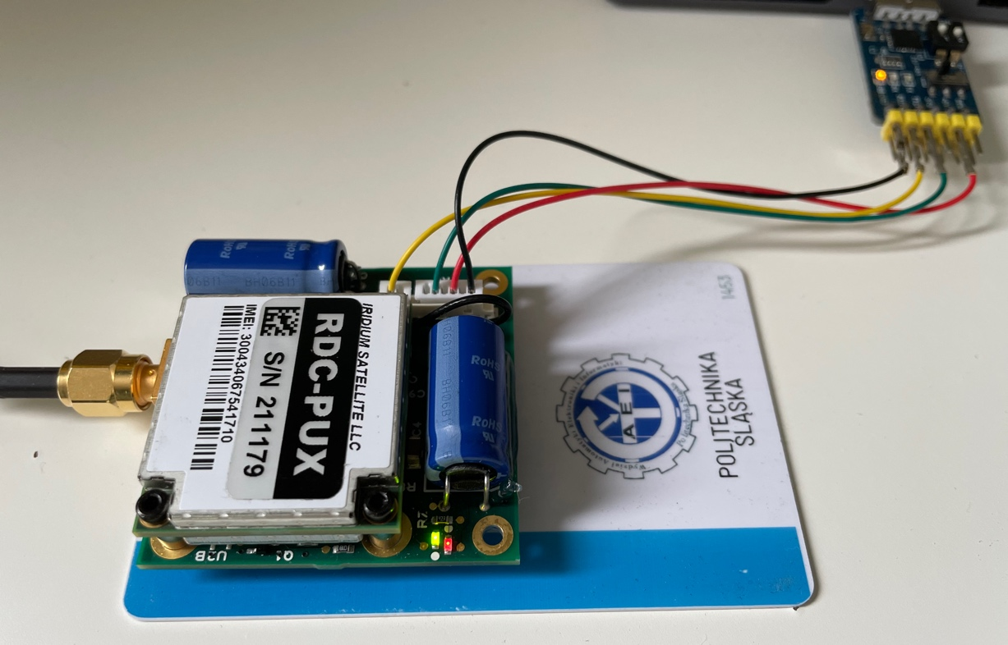
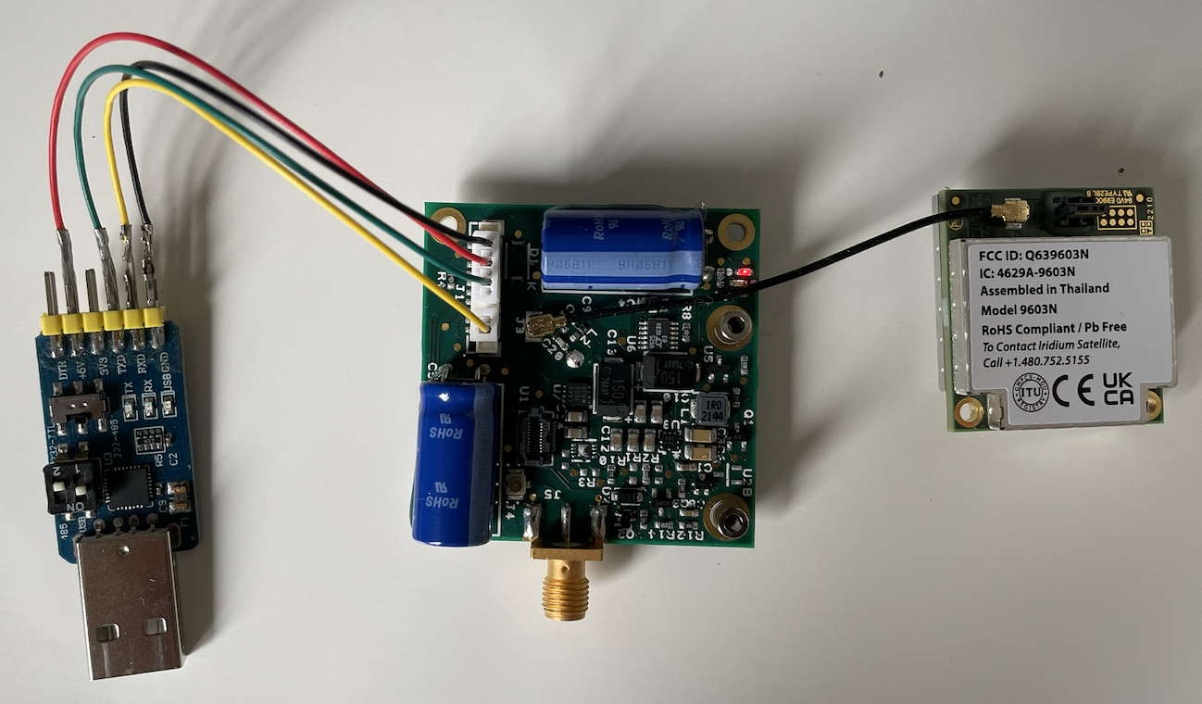
Test scenario and results
Test scenarios:
Direct connection with PC (Linux, macOS)
- AT commands test,
- power consumption tests, latency tests,
- Python scripts development.
Integration with the compute module
Jetson Orin Nano (Linux):
- Python scripts tests,
- Example sensor data generation.
Integration with PixHawk autopilot:
- Autopilot configuration,
- LUA scripts development and test,
- Real data test

Slide 13
Power consumption
RockBLOCK 9603N power consumptions measurements results
The power consumption measurements were conducted at a frequency of 100Hz, utilizing an INA219 sensor in conjunction with an ESP32 module. The INA219 sensor is renowned for its high accuracy in measuring both current and voltage, making it ideal for monitoring power consumption.
The average measured power consumption was 0.25 W. The peak power consumption of 2.5 W was observed only for a few seconds due to the super capacitor charging.

Slide 14
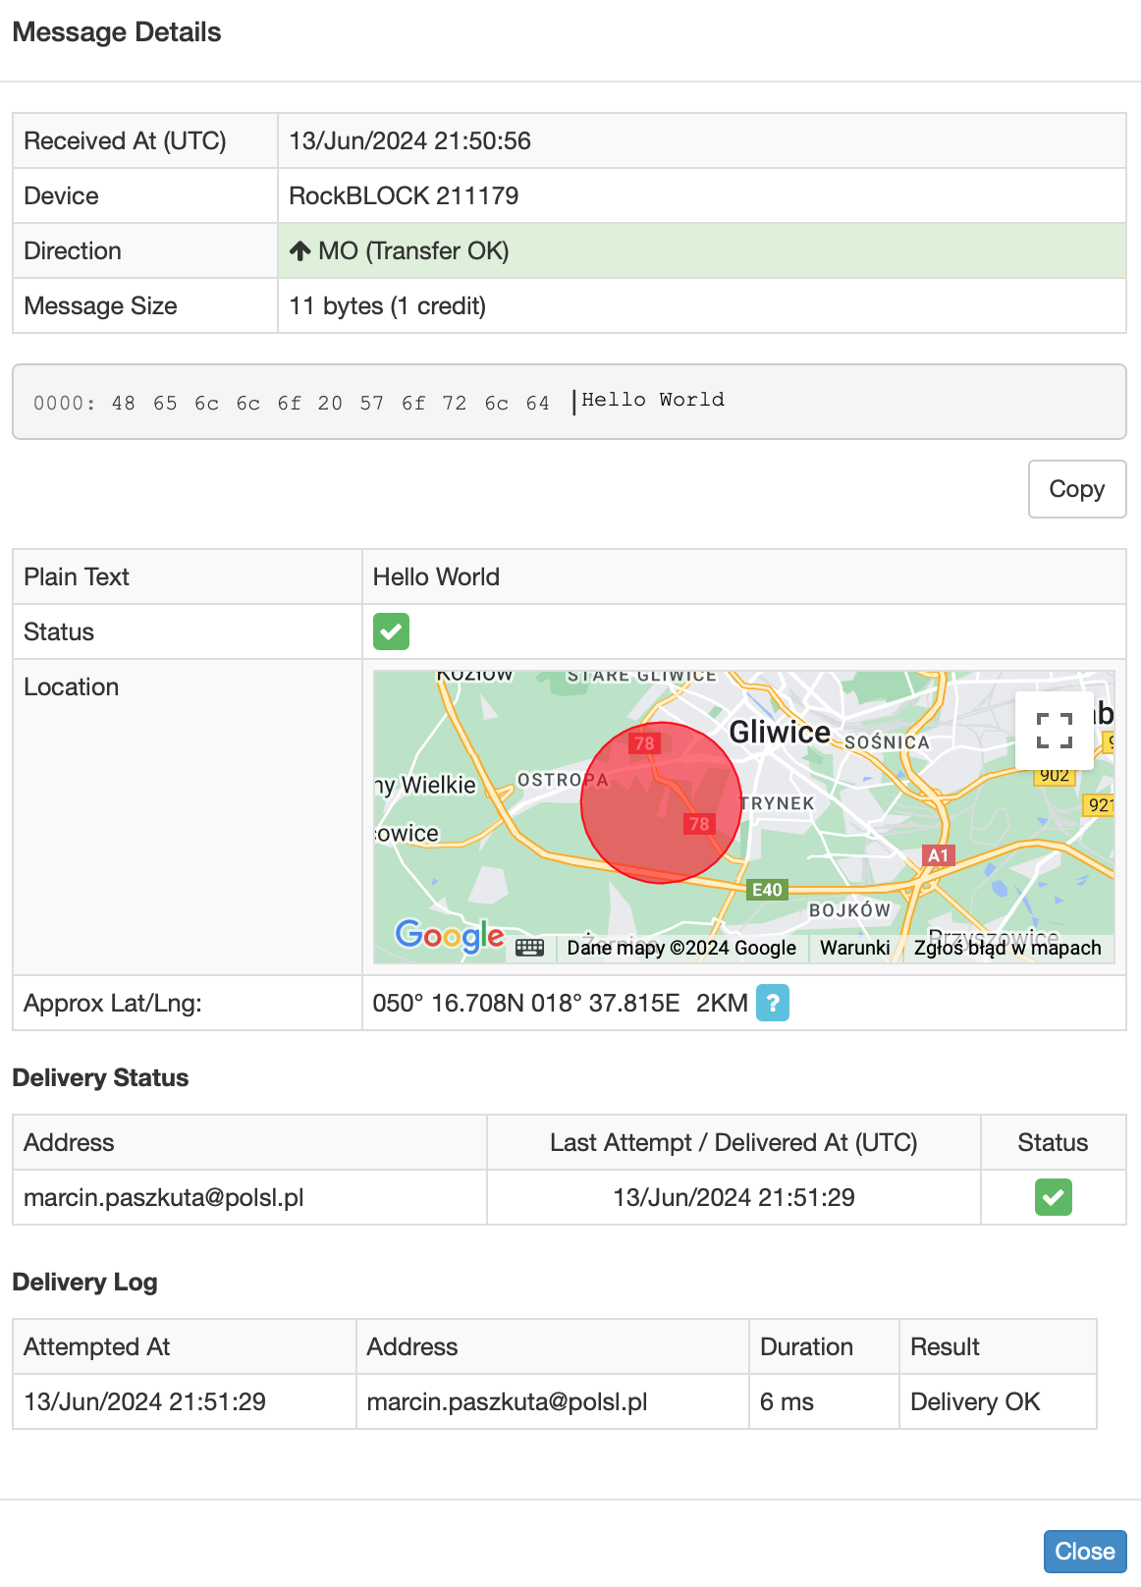
Basics of communication
Sending and receiving messages
The device can prepare messages up to 340 bytes in size. The message can be received as an email or consumed by a REST service.
Each received message from the device is marked with the transmission time to the Iridium network and the estimated position of the transmitter.
Position accuracy ranges from several hundred meters to several kilometers.
Subject | 'Message 1 from RockBLOCK 300434067541710
Body | IMEI: 300434067541710 MOMSN: 1 Transmit Time: 24-05-20 14:59:15 UTC Iridium Latitude: 50.19761 Iridium Longitude: 18.67658 Iridium CEP: 3 km Data: 01020304050607080900102 --
Attachment | 300434067541710-1.bin (11 bytes)

Slide 15
Basics of communication
Sending MT messages using Rock7 API
To send a message to the device, we could use the Rock7 API. An example request is as follows:
https://rockblock.rock7.com/rockblock/MT?imei=300434067541710&username=user&password=pass&data=TEST&flush=yes
In this request:
imei: Specifies the IMEI of the device.
username and password: Credentials for authentication.
data: Contains the message content ("TEST" in this example).
The messages could be sent directly form the webpage:
https://docs.rockblock.rock7.com/reference/testinput

Slide 16
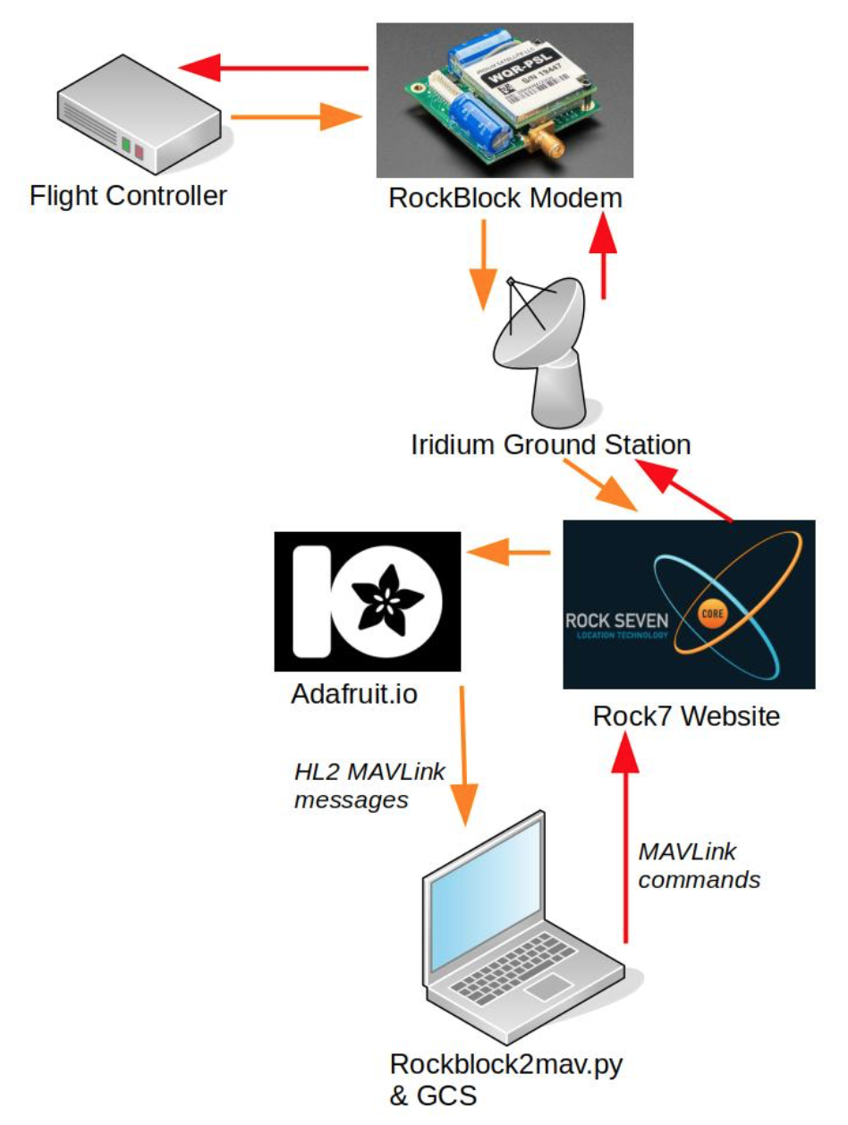
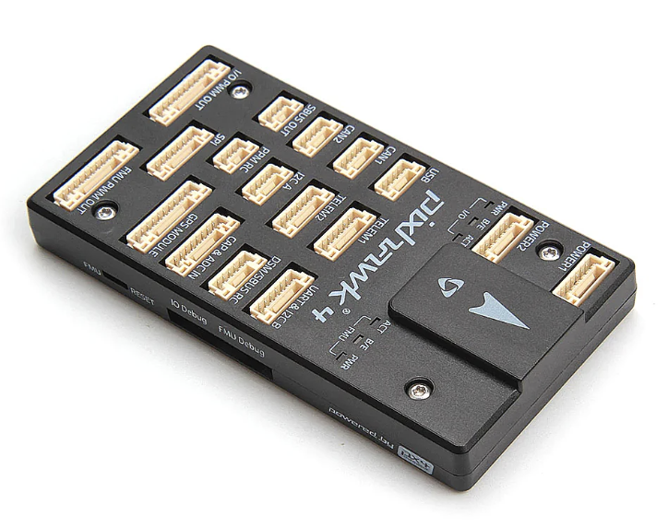
Autopilot integration
PixHawk integration
The RockBLOCK modem can be easily integrated with the PixHawk autopilot using only a 4-wire connection. It can be used with both PX4 and ArduPilot >4.4 software, but different configurations are needed.

Slide 17
Autopilot integration
HIGH_LATENCY2 message structure
Field Name | Type | Units | Description
timestamp | uint32_t | ms | Timestamp (milliseconds since boot or Unix epoch)
type | uint8_t |  | Type of the MAV (quadrotor, helicopter, etc.)
autopilot | uint8_t |  | Autopilot type / class.
custom_mode | uint16_t |  | A bitfield for use for autopilot-specific flags (2 byte version).
latitude | int32_t | degE7 | Latitude
longitude | int32_t | degE7 | Longitude
altitude | int16_t | m | Altitude above mean sea level
target_altitude | int16_t | m | Altitude setpoint
heading | uint8_t | deg/2 | Heading
target_heading | uint8_t | deg/2 | Heading setpoint
target_distance | uint16_t | dam | Distance to target waypoint or position
throttle | uint8_t | % | Throttle
airspeed | uint8_t | m/s*5 | Airspeed
airspeed_sp | uint8_t | m/s*5 | Airspeed setpoint
groundspeed | uint8_t | m/s*5 | Groundspeed
windspeed | uint8_t | m/s*5 | Windspeed
wind_heading | uint8_t | deg/2 | Wind heading
eph | uint8_t | dm | Maximum error horizontal position since last message
epv | uint8_t | dm | Maximum error vertical position since last message
temperature_air | int8_t | degC | Air temperature from airspeed sensor
climb_rate | int8_t | dm/s | Maximum climb rate magnitude since last message
battery | int8_t | % | Battery level (-1 if field not provided).
wp_num | uint16_t |  | Current waypoint number
failure_flags | uint16_t |  | Bitmap of failure flags.
custom0 | int8_t |  | Field for custom payload.
custom1 | int8_t |  | Field for custom payload.
custom2 | int8_t |  | Field for custom payload.
Other supported MAVLink frames
Message ID | Description
CMD_NAV_RETURN_TO_LAUNCH | Return to launch location
CMD_NAV_LAND | Land at location
CMD_NAV_TAKEOFF | Takeoff command
CMD_NAV_VTOL_TAKEOFF | Takeoff from ground VTOL mode
CMD_NAV_VTOL_LAND | Land using VTOL mode
CMD_DO_SET_MODE | Set system mode
CMD_MISSION_START | Start running a mission
CMD_COMPONENT_ARM_DISARM | Arms/Disarms a component
CMD_CONTROL_HIGH_LATENCY | Request to start/stop transmitting over the high latency telemetry

Slide 18
Thank you!
www.eeagrants.org
Facebook, Twitter, LinkedIn, Instagram
YouTube: EEANorwayGrants
Mail: info-fmo@efta.int

