Slide 1





The final conference of the POLNOR-LEADER project
Long-endurance UAV for collecting air quality data with high spatial and temporal resolutions:
An overview
W. Moczulski
Silesian University of Technology
Department of Fundamentals of Machinery Design

Slide 2
LEADER: Long-Endurance UAV for collecting Air quality Data with high spatial and tEmporal Resolutions

Slide 3
General Info
Project LEADER
Project Promoter | Silesian University of Technology, Gliwice, Poland
Project Partners | SkyTech eLab sp. z o.o. University of Warsaw Norwegian Research Centre (NORCE)
Duration of the project | 01.07.2020 – 30.06.2023 (36 months) Extended to 30.04.2024 (44 months)
Total project cost | €1,498,511.44 (incl. own contribution)
Project grant amount | €1,431,855.86

Slide 4
The aim of the project
Design, development and demonstration in an operational environment a system for collecting air quality data with high spatial and temporal resolutions, which includes the following parts:
An innovative High Altitude Long Endurance UAV capable of carrying the system for accurate measurements of air pollution data acquired during the flight path that corresponds to the methodology of sampling which assures high spatial and temporal resolution
An innovative low-weight and low energy-consuming equipment for measuring air pollution data
An advanced ICT system for flight control, communication using optimal channels, collecting and transmitting data, and dynamically planning the flight path.
Furthermore, in the demonstration phase new scientific results concerning air pollution were expected.

Slide 5
Research approach
WP2: Research into long-endurance
UAV
WP3: Methodology for assessing pollution
WP1: Research into general system design
WP6: Integration of the system's components
WP7: Extensive tests in the operational environment
WP4: Low-weight & Energy-efficient sensors system
WP5: ICT System for data managment and path planning

Slide 6
Planned project outcomes (long and short term)
Short-term outcomes:
Development of innovative methodology for collecting air pollution data with high spatial and temporal resolution
Development and implementation of a High-Altitude Long-Endurance (HALE) Unmanned Aerial Vehicle (UAV) – as a carrier for a measuring system for collecting data on air pollution
Development and implementation of an innovative lightweight measuring system for air pollution measurements caused by low-emission sources and produced by physical phenomena of the hemisphere
Development and implementation of a control system for remote and autonomous control of the flight with a subsystem for dynamic path planning
Development and implementation of an upper layer of ICT system for collecting, handling and analysing data acquired during measurement missions
Demonstration of the integrated LEADER system in two kind of missions carried out in the target environment:
  High-altitude transport of pollution observed in Poland
  High-altitude transport of pollution and black carbon in the airspace of Norway
Long-term outcomes:
Know-how of designing High-Altitude Long and Unlimited Endurance UAVs
Implementing the system for systematic research of air pollution

Slide 7
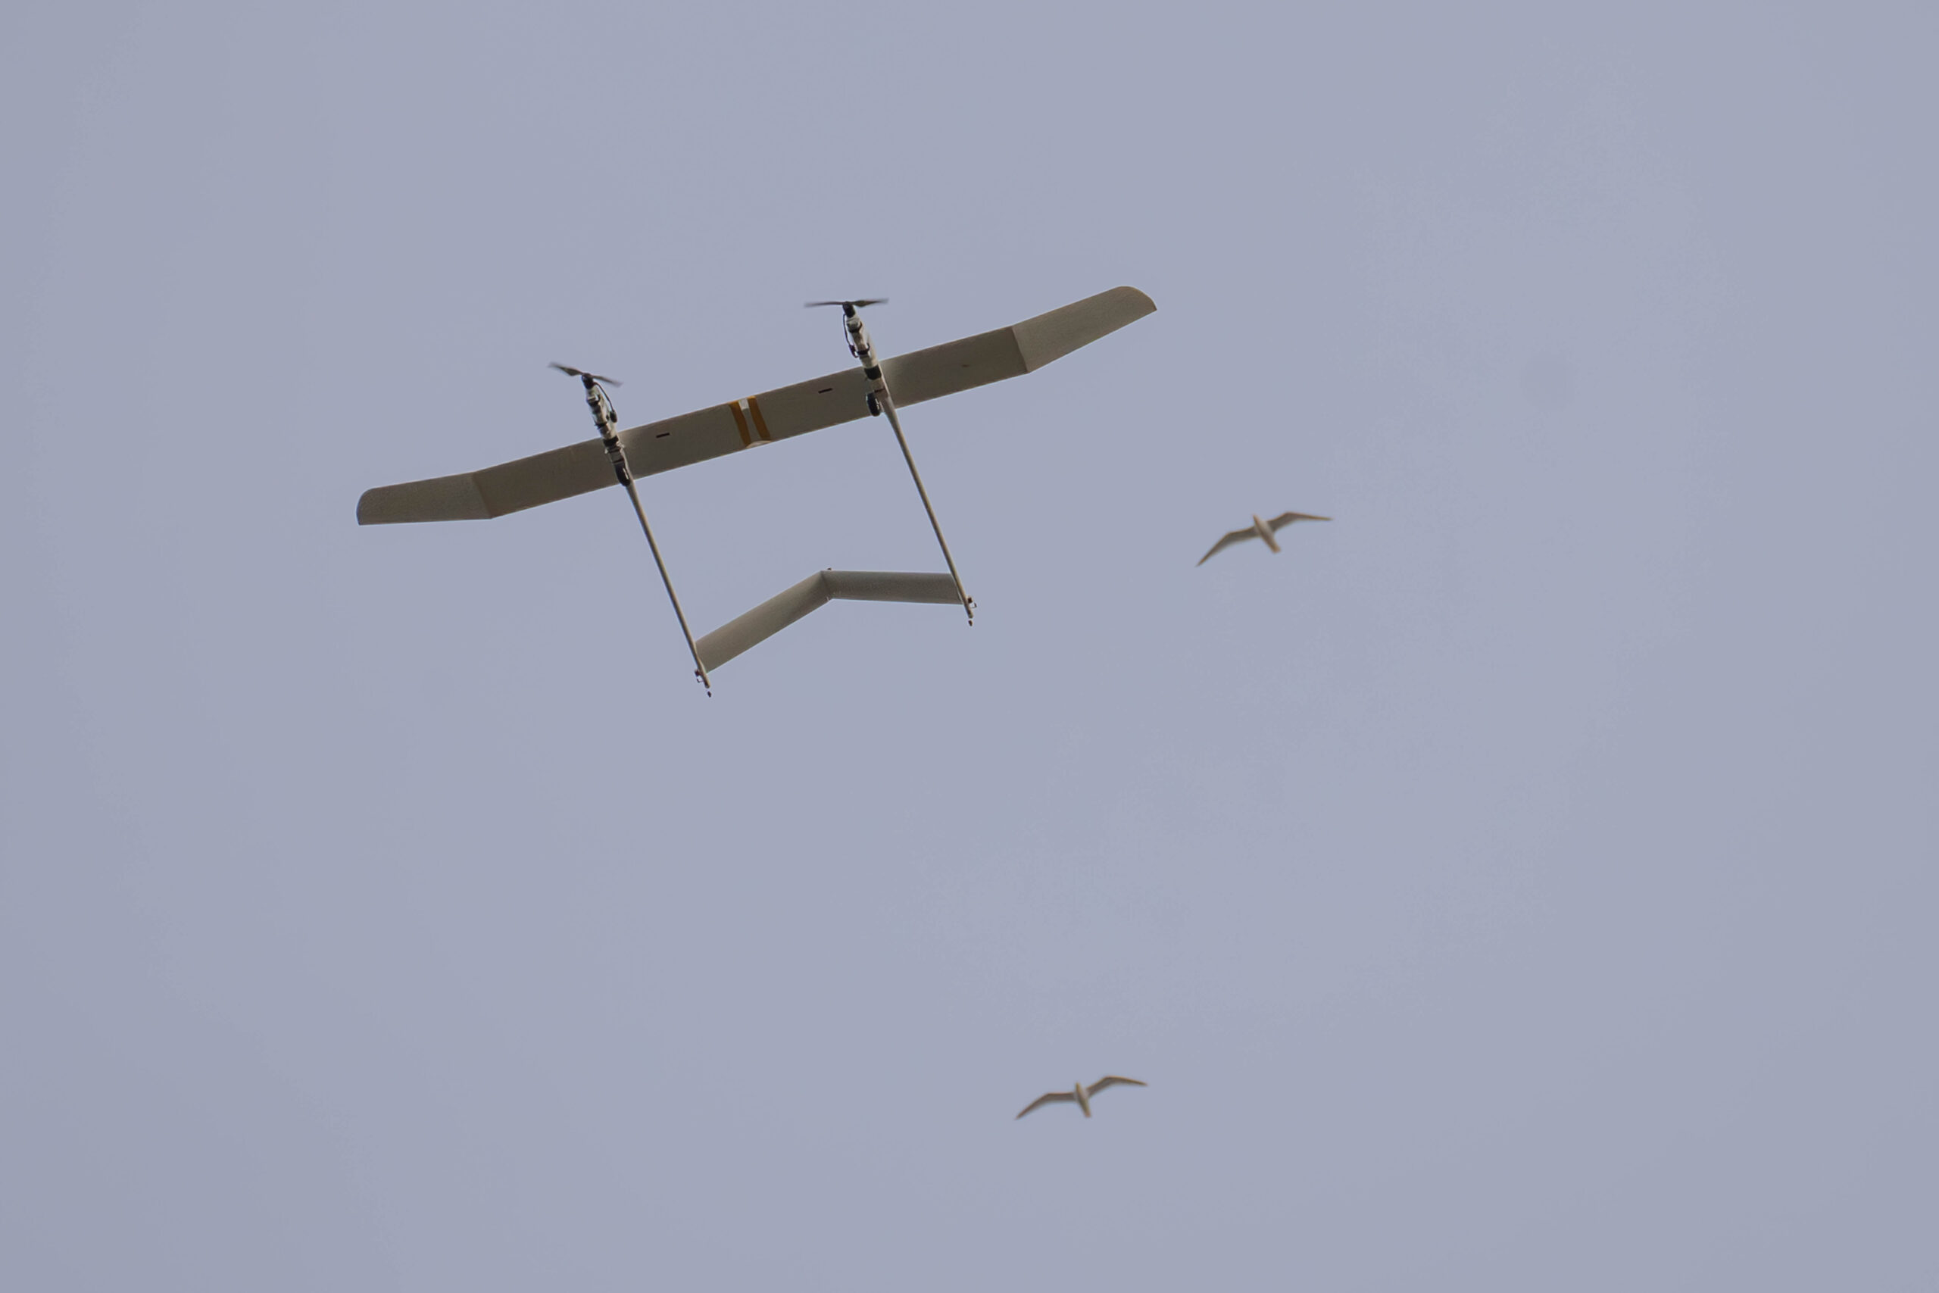
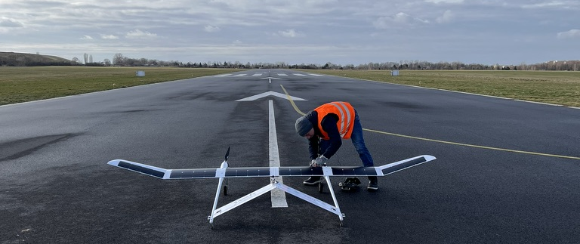
Tests of TS17 at the airfield Gliwice (EPGL)

Slide 8
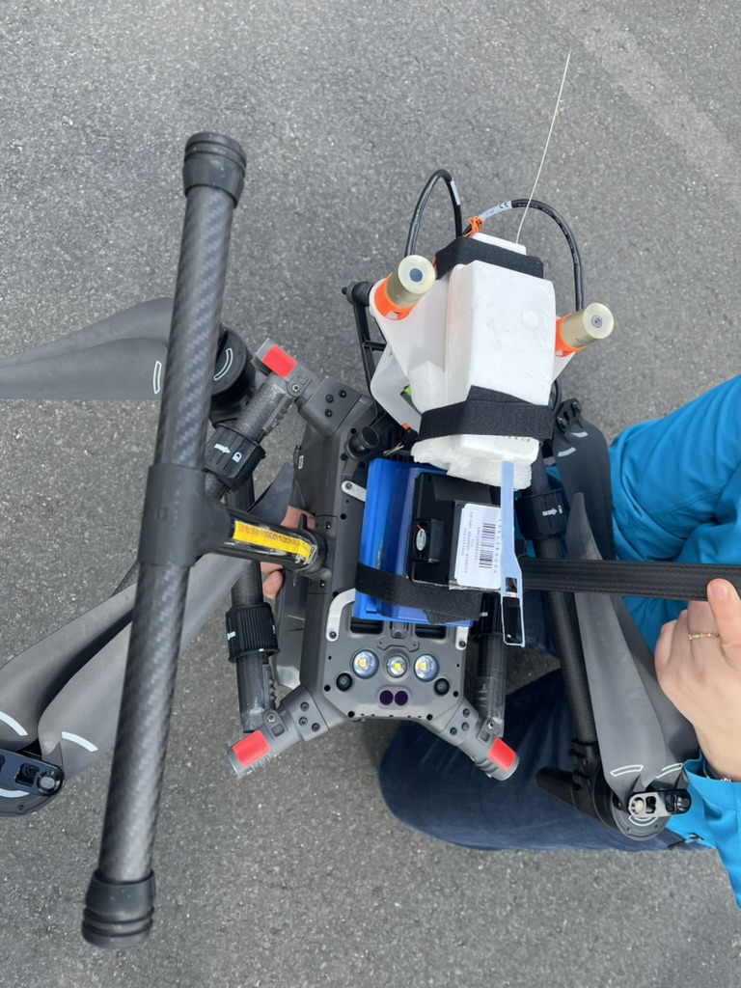
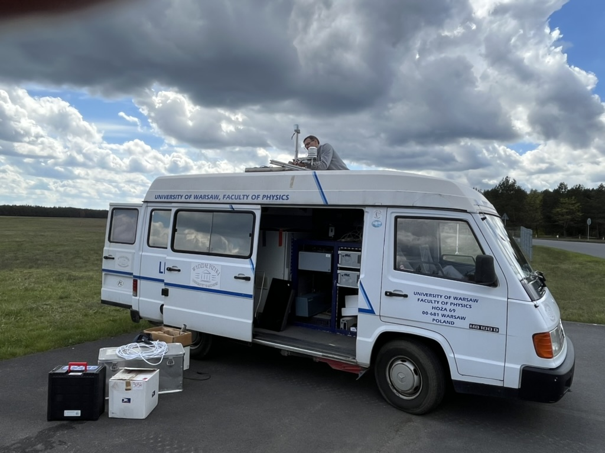
Measuring equipment during tests in North Poland

Slide 9
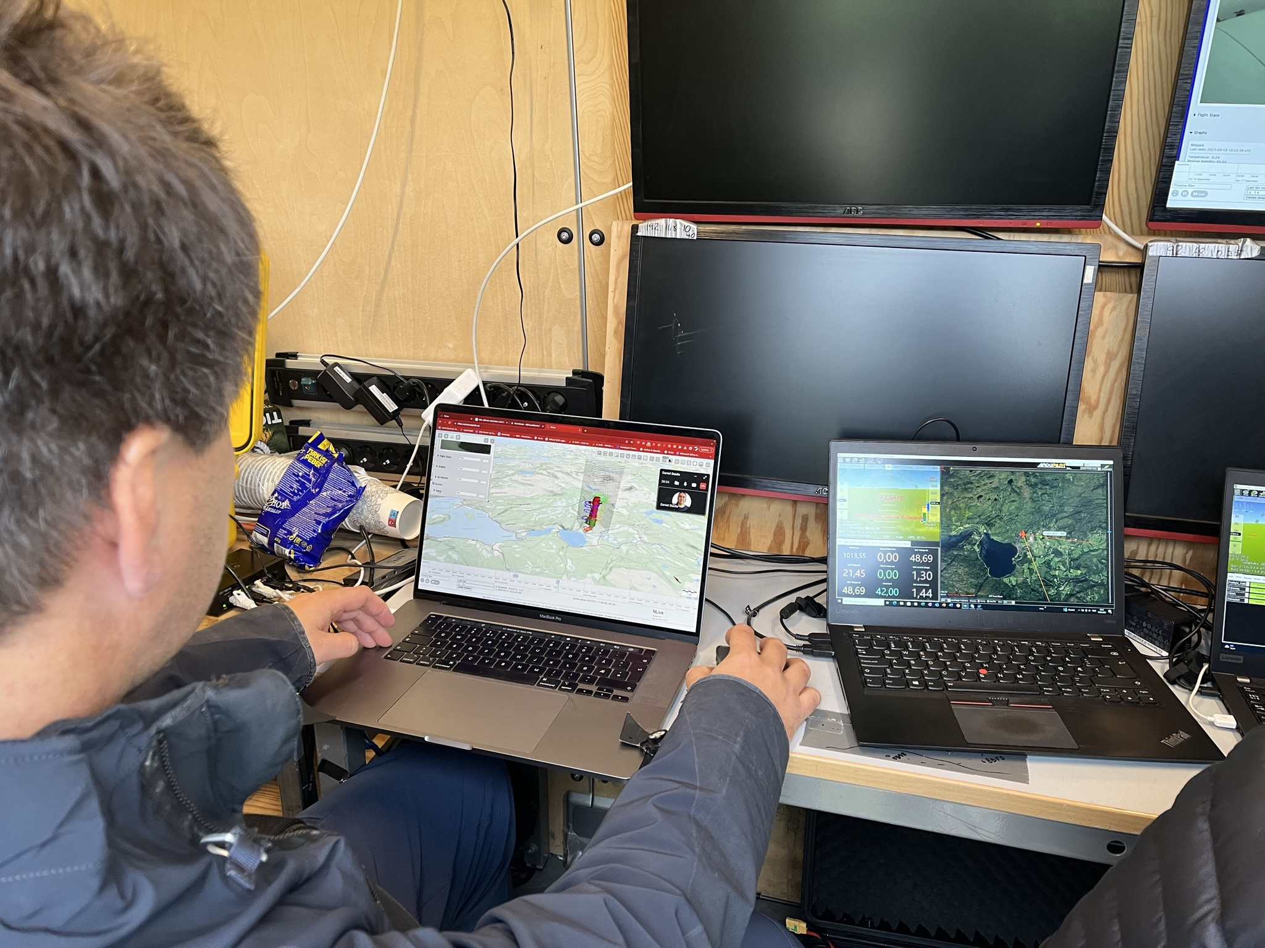
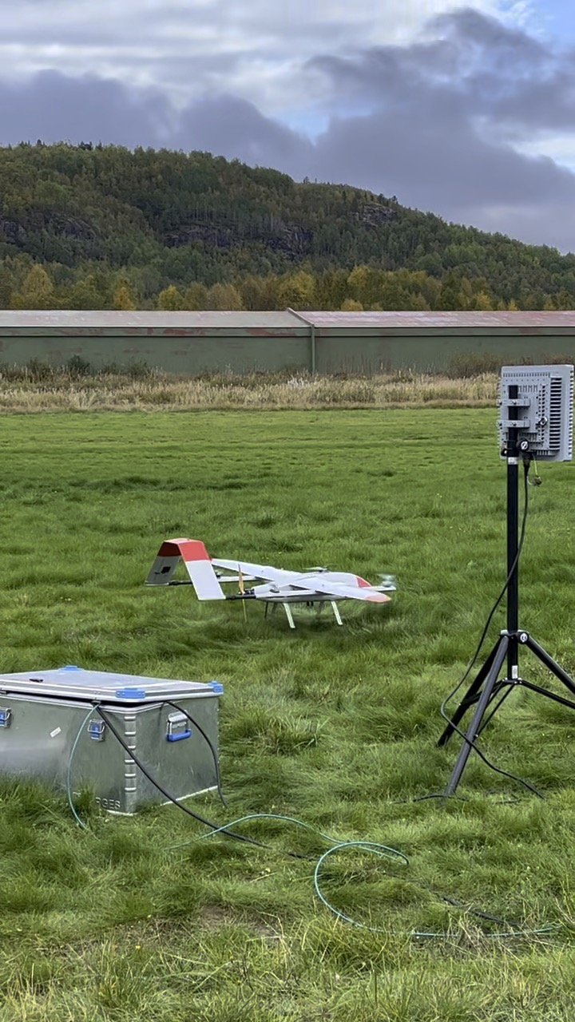
The ICT system – tests in Norway

Slide 10
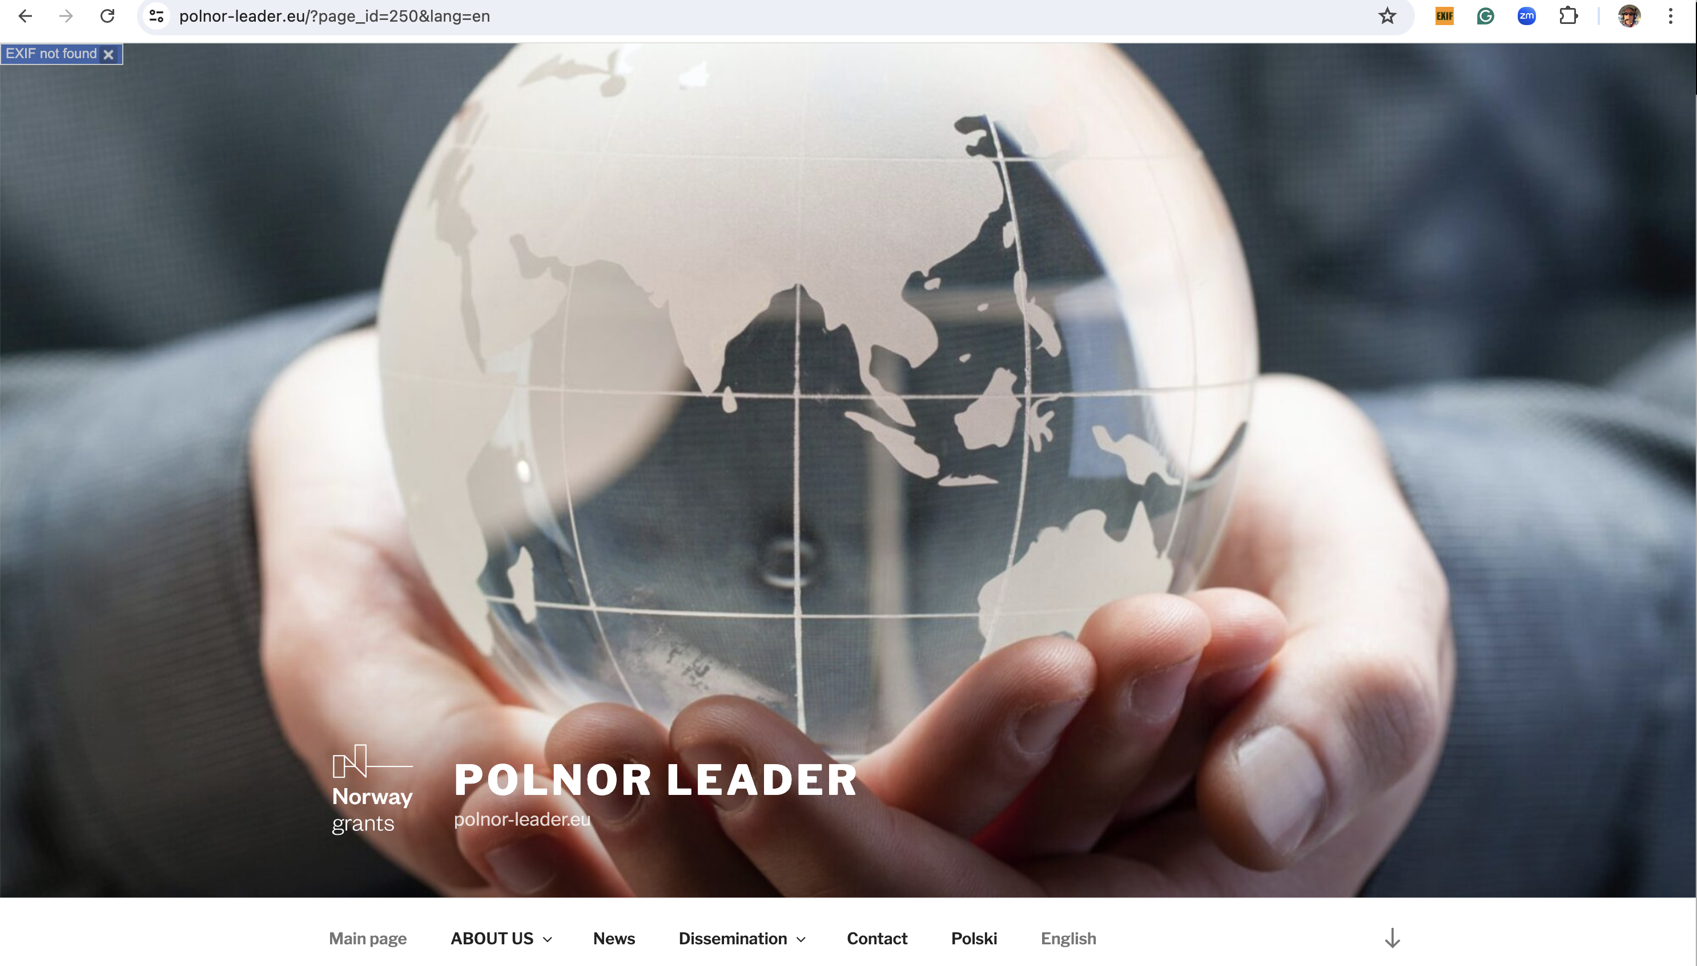
The webpage http://www.polnor-leader.eu

Slide 11
Conclusions
LEADER was an ambitious R&D project that required an efficient collaboration of all the partners.
Innovative conception of the UAV required extensive verification in the virtual environment, and then by means of a 1:7 scale model.
Achieving the assumed performance of the HALE drone could open the possibility of conducting valuable scientific research in the field of atmospheric pollution profiling, while reducing the costs of conducting this research.
Pandemic that occurred before official start of the project made more difficult intermediate contacts of the R&D teams of the partners. It has also affected the possibility to carry out the terrain tests of the complete system.
Due the pandemic and its consequences on international trade and market of parts necessary for the construction of drones, the consortium applied for an extension for the accomplishment of the project.
The results of the project are very valuable from the scientific viewpoint, and also allowed to collect essential knowledge and experience concerning UAV design, development and implementation.

Slide 12
Thank you!
Prof. dr hab. Wojciech Moczulski
Silesian University of Technology
Department of Fundamentals of Machinery Design
18A, Konarskiego Str., PL-44100 Gliwice, Poland
Office: +48 32 237 1028 Mobile: +48 660 840 230
wojciech.moczulski@polsl.pl
https://polnor-leader.eu/

